Slide 1
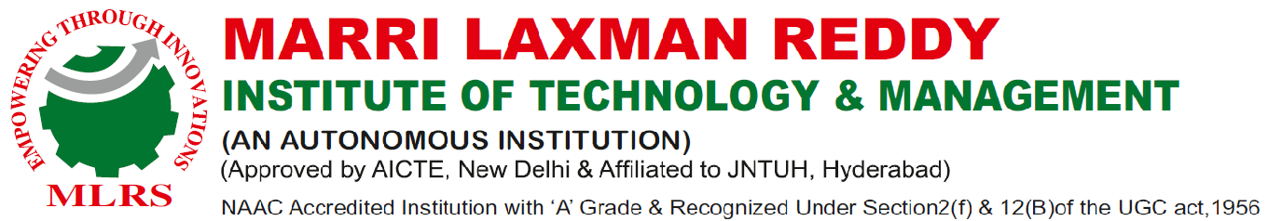
MACHINE LEARNING TECHNIQUES FOR THYROID DISEASE PREDICTION AND MEDICATION PROVISION
Presented by:
P. Nagesh:-217Y1A6791
P. Anvesh:-217Y1A6774
M . Chaitanya:-217Y1A6777
Guide:Mrs.Devi Parvathi
Project Coordinator:Dr.M.Sunitha
Head Of Department:Dr.N.Pushpalatha

Slide 2
Introduction
Advanced machine biology is used in the area of healthcare. It required data to be collected for medical disease prediction. For early-stage disease detection, various intelligent prediction algorithms are used.
The Medical Information System is good with data sets, but intelligent systems are not available for the fast diagnosis of diseases.
Eventually, machine learning algorithms play a key position in solving complex and non-linear problems during the creation of prediction models.
The characteristics that can be selected from the various data sets that can be used as descriptions in a healthy patient as specifically as possible are needed in any disease prediction models. Otherwise, misclassification can
result in a good patient receiving inappropriate care.
The reality of forecasting any condition associated with thyroid illness is also of the greatest cardinal number. The thyroid gland is endocrine in the stomach. It is erected in a lowered portion of the human neck, under the apple of Adam, and assists in the secretion of thyroid hormones which ultimately affects metabolism rate and protein synthesis.
To control body metabolism, these hormones count on how quickly the heart beats and how quickly calories are burned.
The composition of thyroid hormones helps to control the body's metabolism.

Slide 3
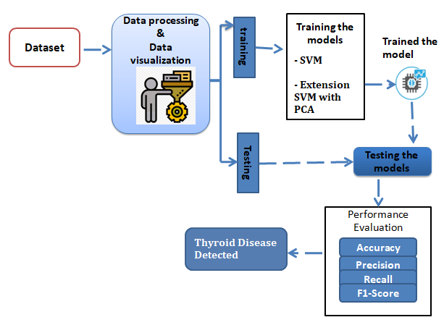
FEASIBILITY STUDY
A feasibility study evaluates a project's or system's practicality. As part of a feasibility study, the objective and rational analysis of a potential business or venture is conducted to determine its strengths and weaknesses, potential opportunities and threats, resources required to carry out, and ultimate success prospects. Two criteria should be considered when judging feasibility: the required cost and expected value.
Three key considerations involved in the feasibility analysis are:
♦ ECONOMICAL FEASIBILITY
♦ TECHNICAL FEASIBILITY
♦ SOCIAL FEASIBILITY

Slide 4
Exisisting System
The existing system for diagnosing thyroid disorders relies heavily on traditional medical diagnostic methods, which often face challenges in accuracy and efficiency. Clinicians primarily depend on symptoms, physical examinations, and laboratory tests to assess thyroid function. However, these approaches may not always provide conclusive results, leading to misdiagnosis or delayed treatment. Additionally, data-cleaning techniques are
employed to preprocess patient data, making it suitable for analysis. Despite efforts to improve diagnostic accuracy, the reliance on subjective assessments and limited data analytics tools hampers the ability to accurately predict thyroid disorders. Consequently, there is a pressing need for more advanced and reliable diagnostic systems that can leverage data-driven approaches, such as machine learning algorithms, to enhance the accuracy and efficiency of thyroid disease diagnosis and estimation.
Disadvantages of Existing System:
Reliance on subjective assessments and traditional diagnostic methods.
2. Limited data analytics tools hamper accurate prediction.
3. Challenges with conclusive results, leading to misdiagnosis or delayed treatment.
4. Inefficient data preprocessing techniques may affect analysis quality

Slide 5
PROPOSED SYSTEM:
The proposed system aims to address the challenge of accurately diagnosing thyroid
disorders by leveraging advanced machine-learning techniques.
Specifically, the system will utilize Support Vector Machine (SVM) and its extension with Principal Component Analysis (PCA) to analyze and classify patient data obtained from hospital datasets.
4.2.1 Advantages of Proposed System:
1. Utilizes advanced machine learning techniques for accurate diagnosis.
2. Integration of SVM and PCA enhances diagnostic accuracy and prediction
capabilities.
3. Incorporates feature selection techniques for improved model performance and
interpretability.
4. Potential to revolutionize healthcare practices by providing more reliable tools for
thyroid disease diagnosis and management.

Slide 6
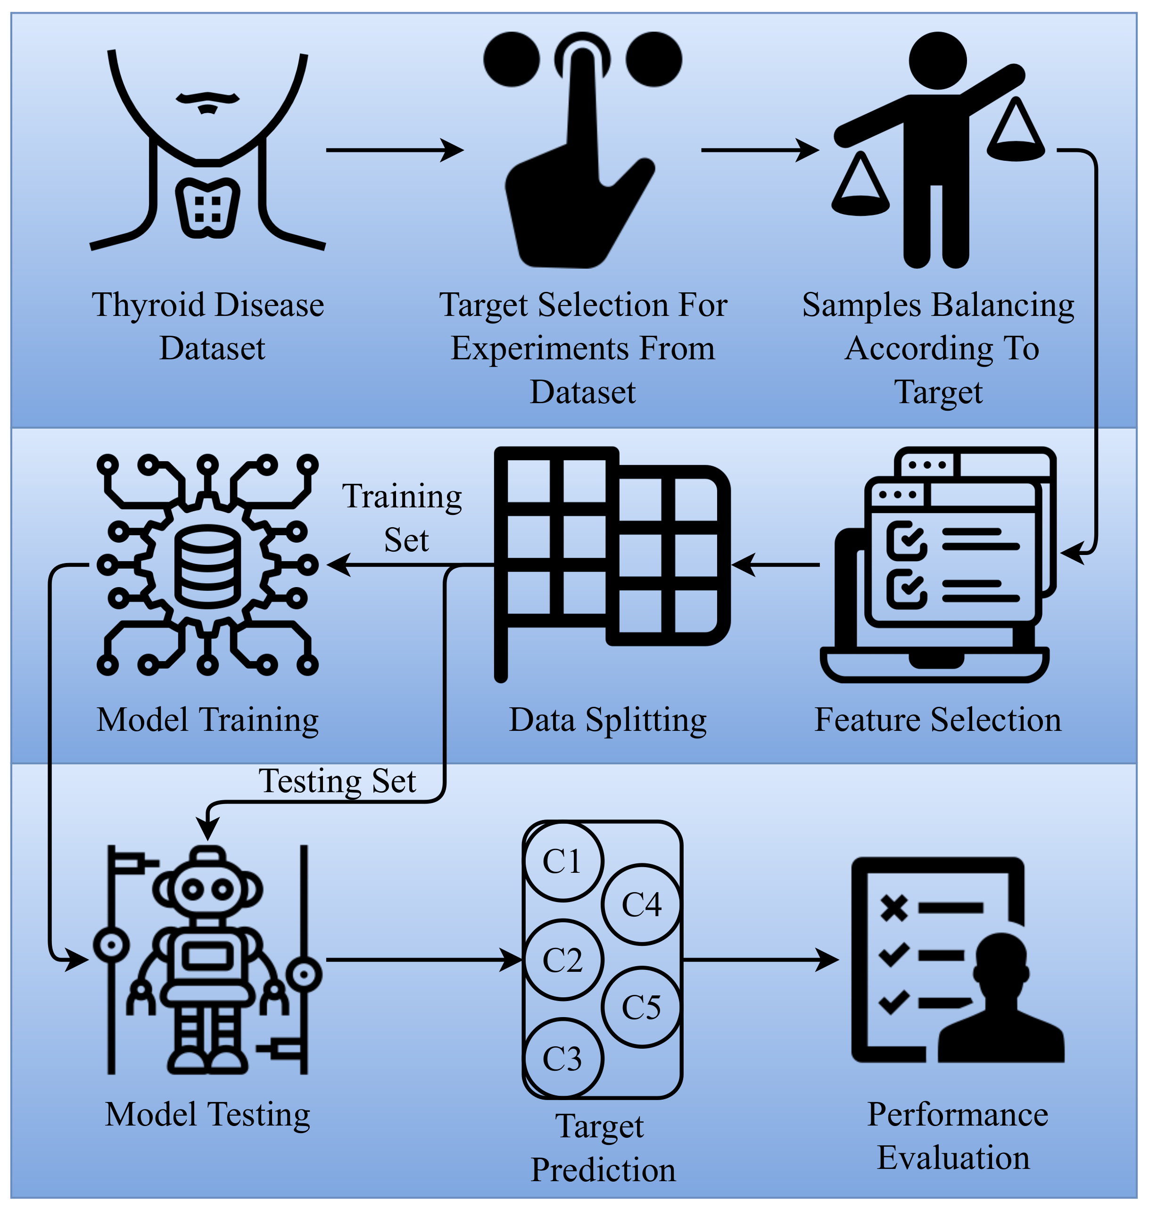

Slide 7
FUNCTIONAL REQUIREMENTS
1. Data Collection
2. Data Pre-processing
3. Training and Testing
4. Modeling
5. Predicting
Non Functional Requirements
• Usability requirement
• Serviceability requirement
• Manageability requirement
• Recoverability requirement
• Security requirement
• Data Integrity requirement
• Capacity requirement
• Availability requirement

Slide 8
System Design

Slide 9
System requirements
Software Requirements
Coding language : Python
Frontend : Python
Backend : Dijango
Database : MySQL server
Hardware requirements
Processor : i5
RAM : 4GB RAM
Hard disk : Minimum 256GB

Slide 10
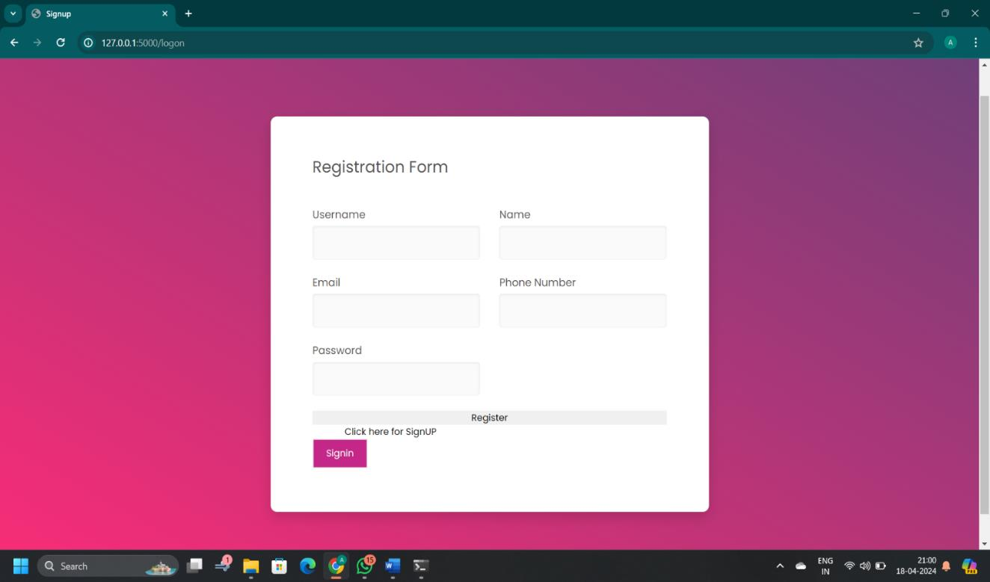
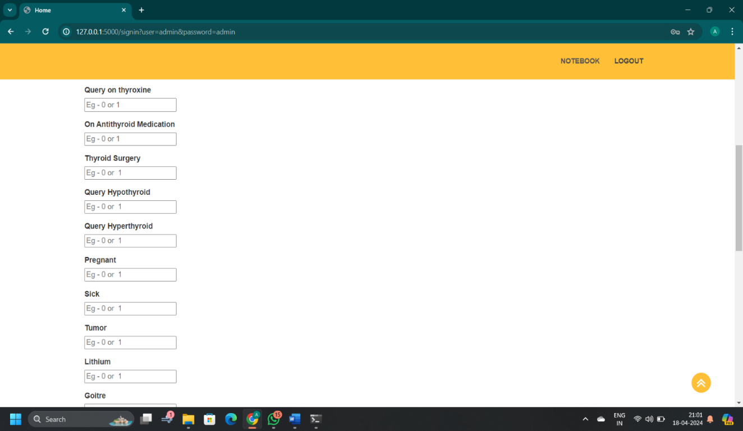

Slide 11
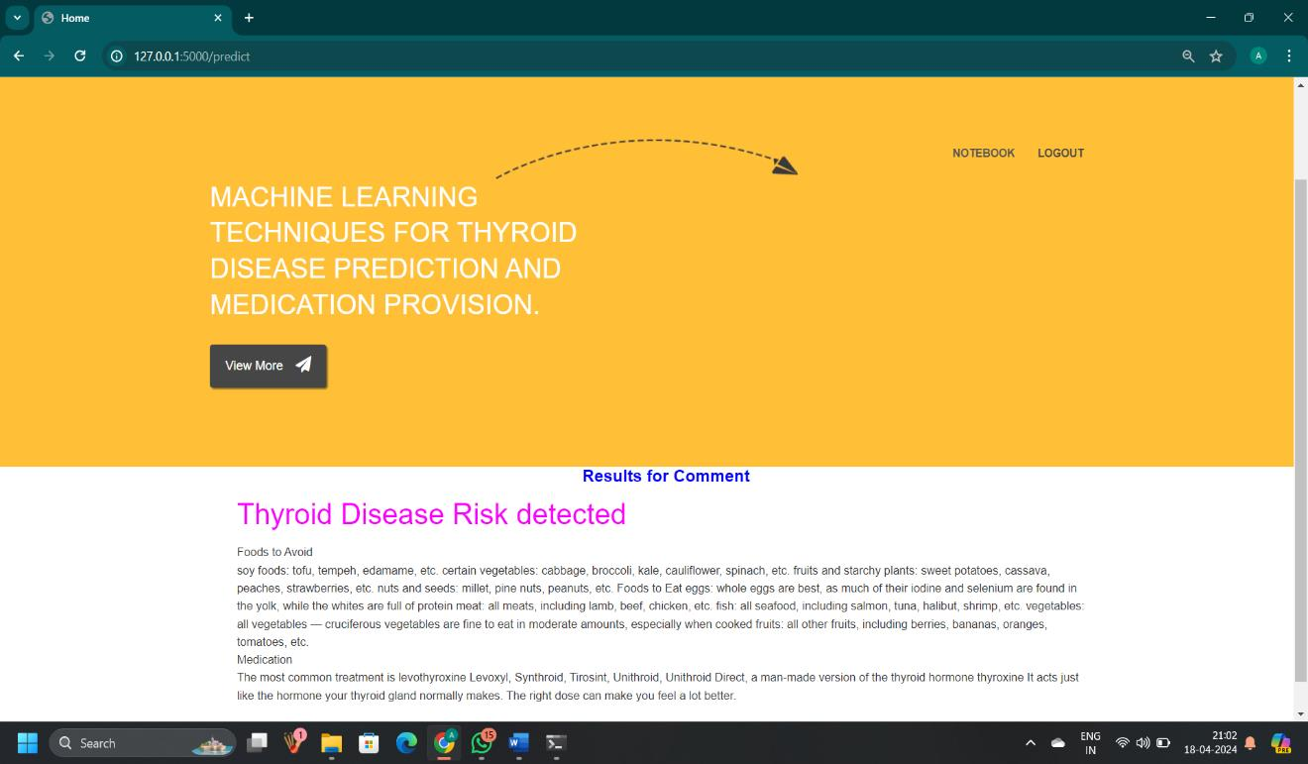
Results

Slide 12
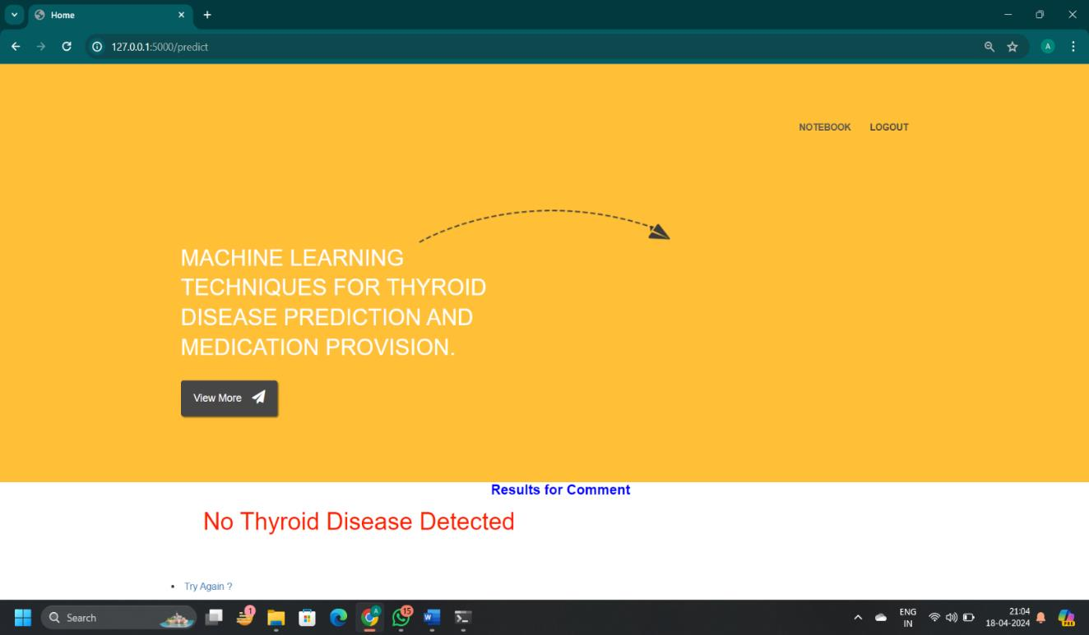

Slide 13
Conclusion
In conclusion, this study demonstrates the efficacy of machine learning algorithms,
particularly Support Vector Machine (SVM) and SVM with Principal Component Analysis
(PCA), in diagnosing thyroid disorders with remarkable accuracy. With SVM achieving an
accuracy of 89.38% and SVM with PCA further enhancing it to 96.19%, the results
underscore the potential of these techniques in revolutionizing thyroid disease diagnosis
and prediction. The high accuracy rates attained in this research validate the feasibility and
effectiveness of employing machine learning in healthcare settings, particularly in complex
medical domains like thyroid disorders.

Slide 14


